Slide 1
FY24 Budget Training

Slide 2
Agenda
01 Questions & Instructions
02 Budget Template
03 Positions
04 SOR
05 YTD Budget Variance
06 Other

Slide 3
01
Questions & Instructions

Slide 4
Questions…
Please put all questions and/or comments in the chat!
We will answer as many questions after the presentation as possible. Any questions not addressed, as well as those asked and answered, will be included in a document that will be sent to all after the training concludes.
The training is recorded, and the recording link will be sent with the Q&A.

Slide 5
Instructions
Step-by-step instructions for the budget workbook are located on the Instructions tab.

Slide 6
02
Budget Template

Slide 7
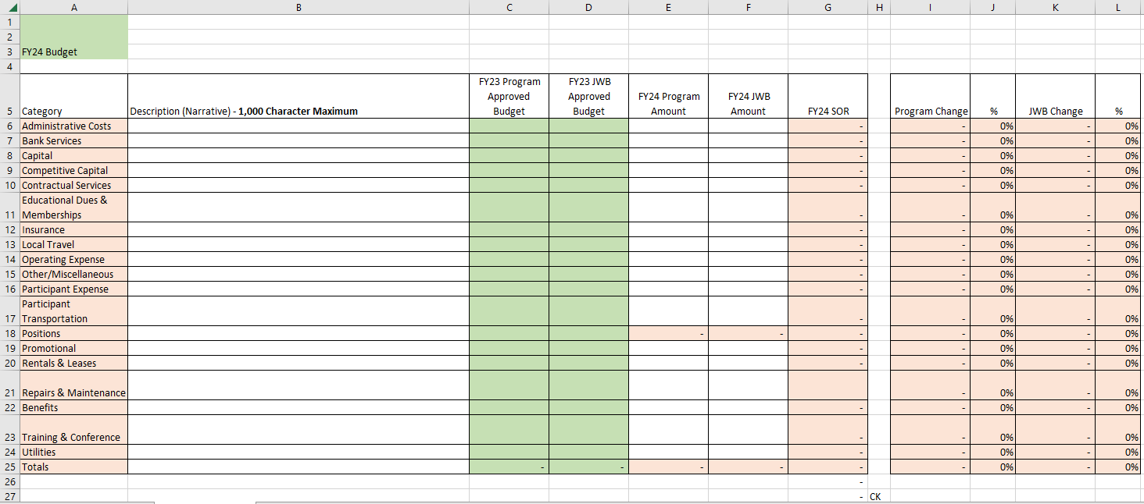
Updated Budget Template
The budget template is the main budgeting document. It includes all possible budget categories for FY24.
Your program specific budget template is prepopulated with the originally approved FY23 program and JWB funded budget amounts in columns C & D.

Slide 8
Completing the Budget Template
A
B
D
C
Include a description (narrative) for each budget category in column B.
Enter the total dollar amount for both FY24 Program and JWB amounts in columns E & F. If you include subtotals in your description, these amounts must equal the sum of those subtotals.
The position amounts are tied to the Positions tab and will populate automatically.
The FY24 SOR column is a formula and will automatically calculate.

Slide 9
Completing the Budget Template
E
G
F
Columns I through L reflect the dollar and % changes from prior year and will calculate automatically. If these reflect a change more than $1,000 AND more than +/- 10%, you must include a reason for that change in the description in column B.
Cell G26 will populate with the total SOR requested on the SOR tab, and cell G27 should be $0. If it’s not, there is an error that should be corrected before submitting your budget to you JWB.
The total of Column F, FY24 JWB Amount, must equal the FY24 funding renewal amount. If it doesn’t, please review, correct/update before submitting to JWB.
There is a chart of accounts in the JWB Financial Policies and Procedures for Funded Agencies included on our website. This includes descriptions of what costs are included in our budget categories. We revised this to eliminate the subcategories within budget categories.

Slide 10
03
Positions

Slide 11
Updated Positions Tab
A
The position tab is prepopulated with your originally approved FY23 positions and includes the gross, program & JWB amounts, and the FTE.

Slide 12
Completing Positions
A
B
Please complete the FY24 section. That includes Columns I through L, and O. Enter the staff name, gross, program & JWB amounts, and the FTE. Please make sure that the FY24 amounts reflect any approved WFS annualized funding by position.
If you are requesting new positions, complete columns A and B with the title and new position number. Please use the next available number in your program position sequencing. Then, complete the FY24 section for your new positions as explained above.
All other columns will populate based on formulas.

Slide 13
Completing Positions
B
A
If you are comfortable noting reasons for changes, feel free to use Column V, JWB Comments & Questions, to document those reasons. For example, if you are eliminating a position and adding a new one, you can state that in Column V on those line items. The eliminated positions will have $0 amounts in FY24.
All other columns will populate based on formulas.
The total FY24 program and JWB salaries will automatically populate on the budget template.

Slide 14
04
SOR

Slide 15
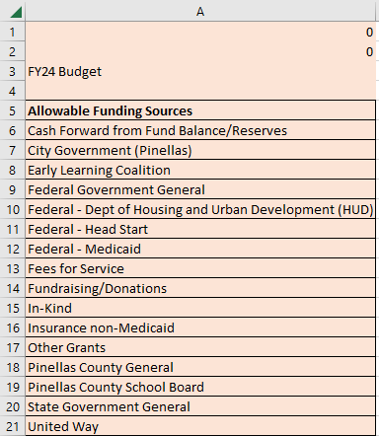
Completing SOR
Please complete all columns on the SOR tab. If JWB funds the entire program, please note "N/A" on the schedule.
Choose an eligible funding source from the SOR Categories tab. Please use a SOR category once and include all funding from that revenue source.
Enter the amount and a narrative for each eligible funding source. The amount must equal the sum of any subtotals used in the narrative.
Cell G26 on the budget template will populate with the total SOR requested on the SOR tab, and cell G27 should be $0. If it’s not, there is an error that should be corrected before submitting your budget to you JWB.

Slide 16
05
YTD Budget Variance

Slide 17
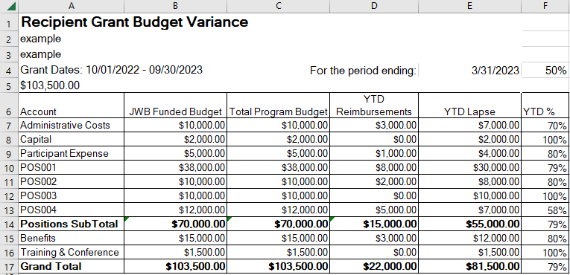
YTD Budget Variance
New this year! Please review your most recent YTD variance report. This represents current year spending to date, which is often a good indicator of financial needs in future years.
This report will show actual expenses through 3/31/2023 if your program has submitted reimbursements timely. If your program is not timely, the report will only report on expenses through the date of your last reimbursement request.

Slide 18
06
Other

Slide 19
Other
Please return the completed workbook to your assigned Senior Program Financial Analyst no later than June 16, 2023.
We will review budgets in the order they are received. The budgets will then be forwarded to your Senior Program Consultant and Evaluator for a programmatic review.
Program Finance will reach out to you to determine if any needed updates can be made via email, or if a TEAMS meeting is more appropriate. If you prefer a meeting, please let us know!

Slide 20
Thank you!

