Slide 1
Recipient Training
Juvenile Welfare Board of Pinellas County

Slide 2
Juvenile Welfare Board Welcome
Juvenile Welfare Board
AmpliFund Implementation Team
Laura Krueger Brock, Chief Financial Officer
Laura Peele, Director of Information Technology
Stacey Gill, Senior Program Financial Manager
Shannon Phillips, Software Applications Support Analyst

Slide 3
Agenda
Welcome & Overview
Getting Started in AmpliFund
Entering Expenses & Submitting a Reporting Period & Payment Request
Completing Position Change Request Form
Completing an Other Funding Change Form
Submitting an Amendment Request
Reporting
Q&A

Slide 4
House Keeping
Submit questions via chat.
JWB Finance staff will be monitoring Program-related questions.
Shannon will be monitoring AmpliFund questions and will address at the end.

Slide 5
In-Product Review

Slide 6
Support

Slide 7
JWB Support Resources
JWB Provider Software Support Email:
Provider-support@jwbpinellas.org
JWB Provider Software Support Website:
https://www.jwbpinellas.org/providers/

Slide 8
AmpliFund Support
Submit a support ticket:
support@amplifund.zendesk.com
Visit the support portal:
https://amplifund.zendesk.com
Supported Browsers:
Google Chrome (current supported releases)
Mozilla Firefox (current supported releases)
Microsoft Edge (current supported releases)
Microsoft IE 11 +
Apple Safari 10+

Slide 9
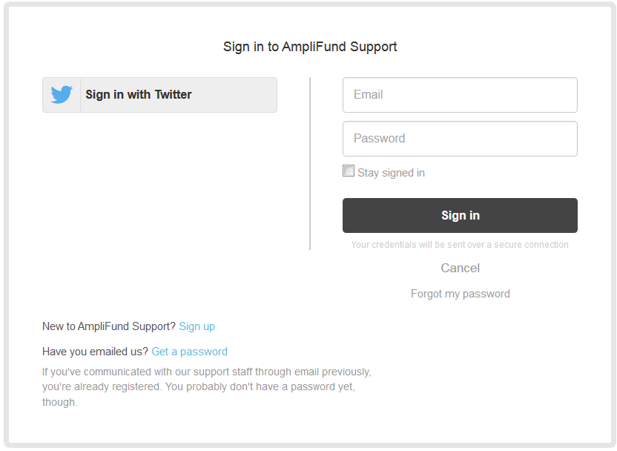
AmpliFund Support Site
Go to https://amplifund.zendesk.com
Click the Sign up link
Enter your full name
Enter your email address
Complete the I’m not a robot check
Click the Sign up button
A welcome email from support@zendesk.com will be sent to you via email
Click the link to set your password

Slide 10
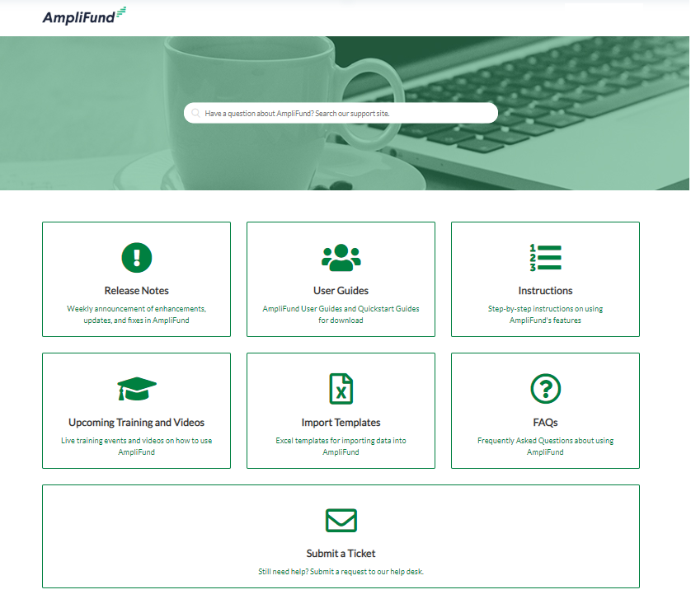
AmpliFund Support Site

Slide 11
Appendix
Support Slides

Slide 12
Navigating AmpliFund
2
3
Left Navigation -shows on every page
User Navigation –includes account information, change password, message center, support, terms and conditions, applicant portal, and logout
Options Toolbar –displays icons to perform functions available on the current page, icons vary based on page
1
1

Slide 13
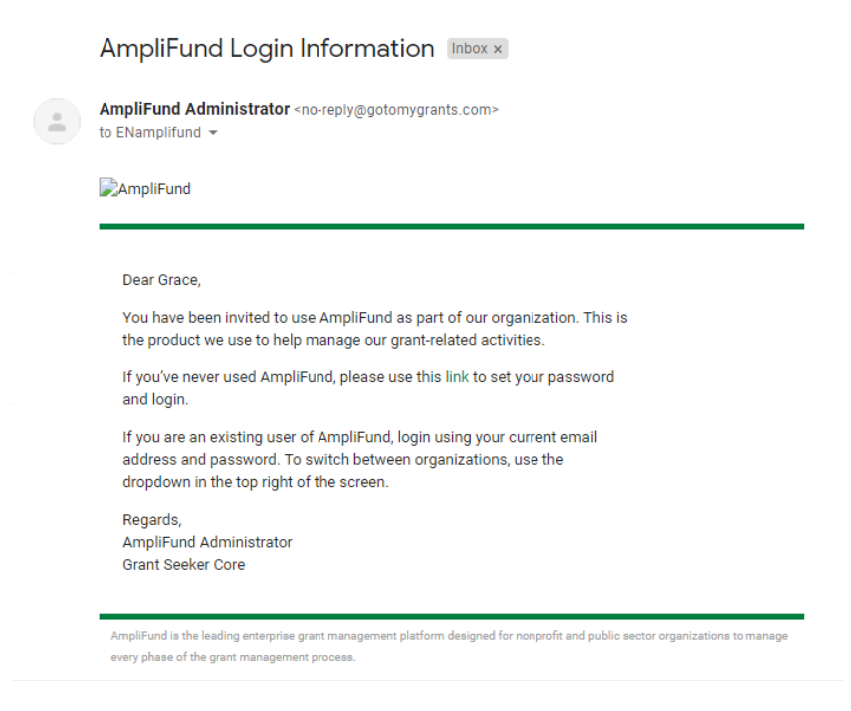
New AmpliFund Users
AmpliFund generated emails from no-reply@gotomygrants.com
If you do not receive your welcome email, check your spam folder
Links in AmpliFund emails expire in 72 hours; contact AmpliFund Support if you need to have your email resent
User First Name

Slide 14
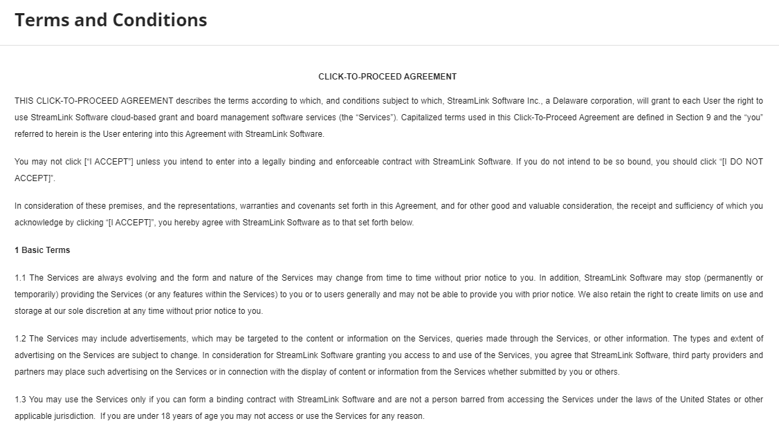
Creating a Password & Logging In
Click the link in the invitation email
Enter and confirm a password
Click the Submit button
Enter email and password in the Login window and click the Login button
Click the I Accept button to accept the AmpliFund terms of use

Slide 15
Adding Users

Slide 16
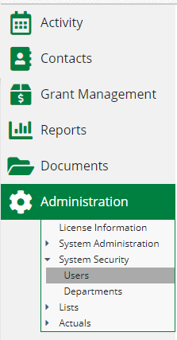
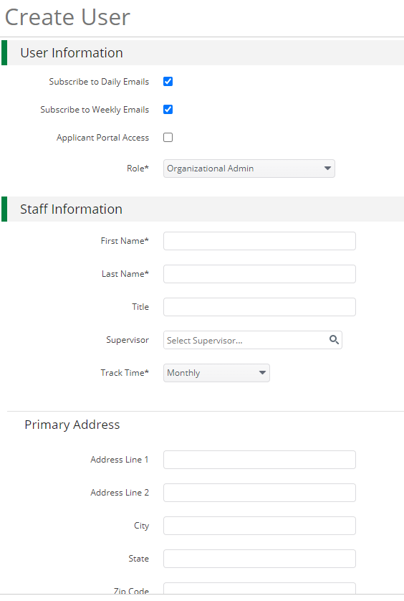
Creating Additional Users
1
Open Administration > System Security > Users
Click the + icon in the top right hand corner to create a User
Enter user preferences & information
Select the User’s Email Preference
User role
User’s First Name, Last Name, and E-Mail Address
Click the ‘Create’ button
2
3

Slide 17
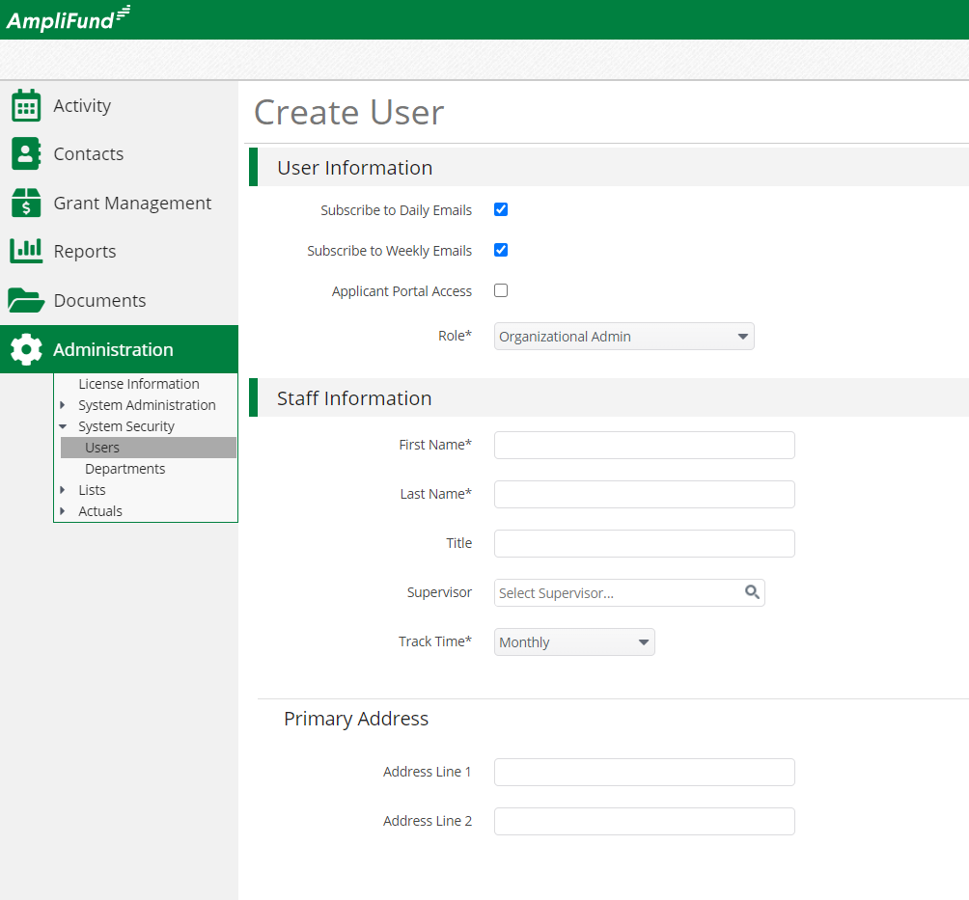
User Options
Subscribe to Daily/Weekly Emails
Set to Yes to receive daily and/or weekly emails from AmpliFund with tasks/reminders
Role*
Organization Administrator
Full view and edit access to your organization’s AmpliFund account
Executive
View only access to your organization’s AmpliFund account
Department User (No Salary)
Only has access to budget or performance plan items to which you assign the user as the Responsible Individual
Department User (Salary)
Has access to budget or performance plan items to which you assign the user as the Responsible Individual including personnel line items

Slide 18
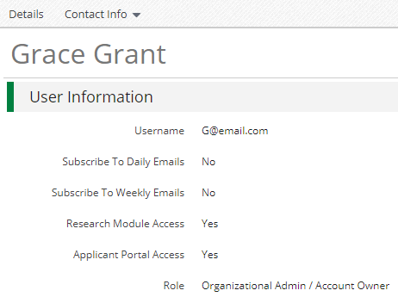
Sending an Invitation to a User
Click the in the Icon Bar
In the confirmation pop-up window, click Send Invitation
Link is active for 72 hours
Note: An Organization Administrator can resend the invitation email to a user by going to Administration > System Security > Users. Click the envelope icon next to the User’s name and confirm.

Slide 19
Updating Grant Award

Slide 20
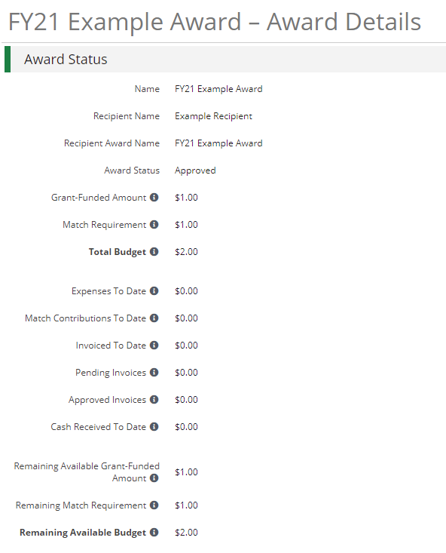
Adding Grant Manager in Award Details
Go to Grant Management > Grants
Click the ‘pencil’ icon next to grant name to edit
Update the Recipient Grant Manager name & Recipient award name (optional)
Click the Save button in the right corner of the screen
1
3
2

Slide 21
Accessing Budget

Slide 22
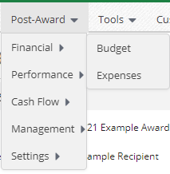
Accessing Budget
Go to Grant Management > Grants
Click the grant name
Click on Post Award > Financials > Budget
3
1
2
Grant Performance Plans and Budgets have already been created in your account.
*Page 10 of the AmpliFund Recipient User Guide

Slide 23
Expense Entry

Slide 24
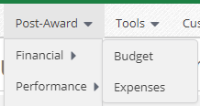
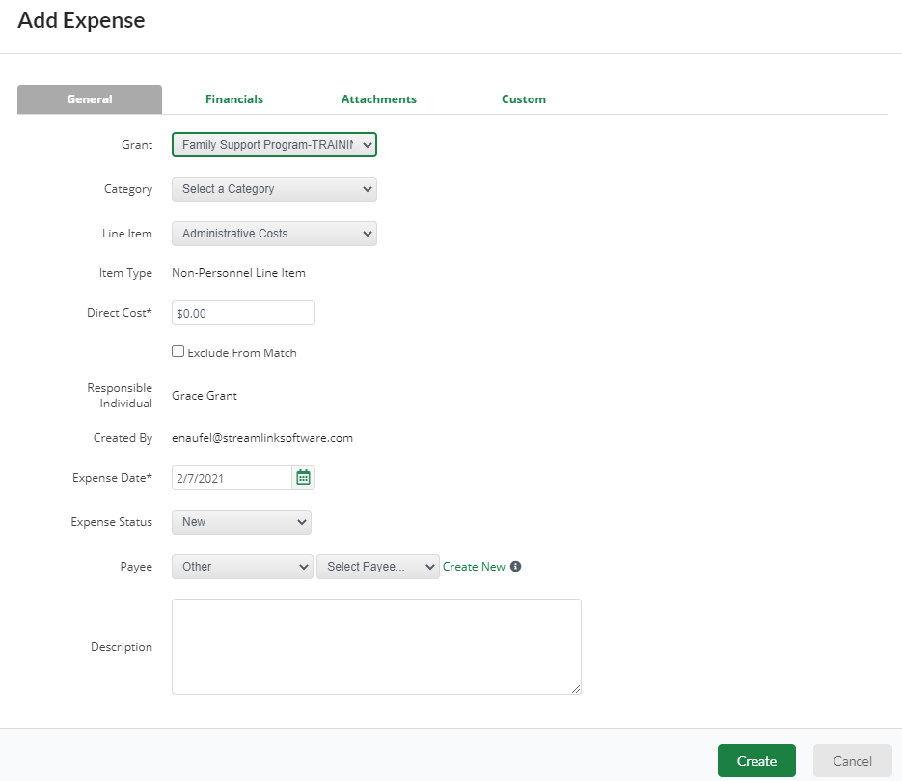
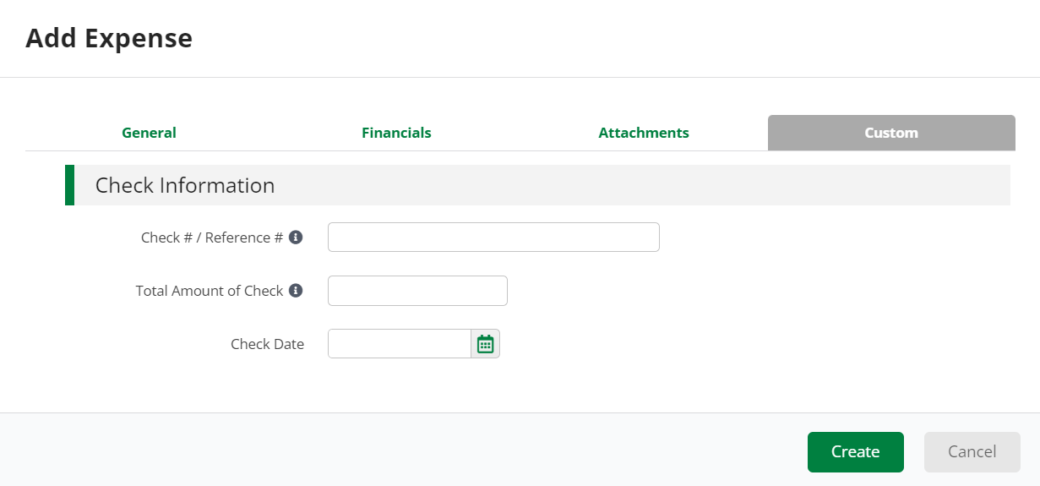
Expense Entry
From the Grant click on Post Award > Financial > Expenses
Click on the plus icon to add a new expense
Add expense information under Expense tab. Expense status must be Reviewed to pull into a Payment Request.
Add details under Custom tab then click Create.
1
3
2
4

Slide 25
Submitting a Reporting Period & Payment Request

Slide 26
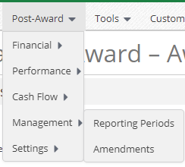
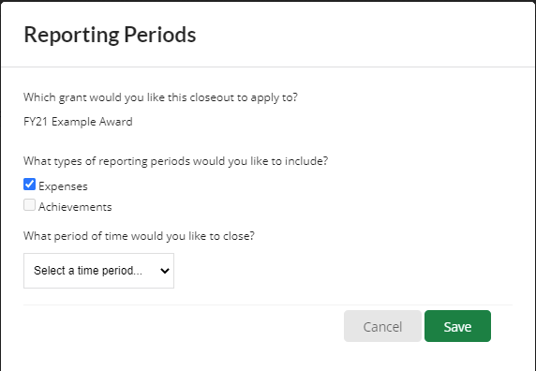
Generating a Reporting Period
From the Grant click on Post Award > Management > Reporting Periods
Click on the plus icon in the upper right-hand corner
Select Expenses and Time Period then click Save
Review expenses & details, click Close to submit reporting period to JWB
2
1
3
4

Slide 27
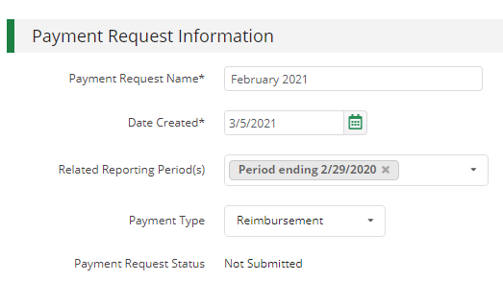
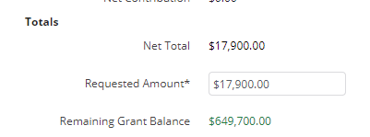
Generating a Payment Request from Reporting Period
From the Reporting Periods click on the payment request icon
Enter name (Naming convention: Month + year OR Quarter #) and date created
Type in total requested amount
Add any additional comments & upload files (such as GL and Payroll backup) to JWB
Click submit to send to JWB
1
2
3
4
5

Slide 28
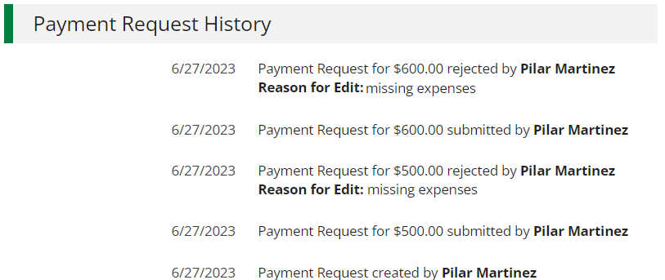
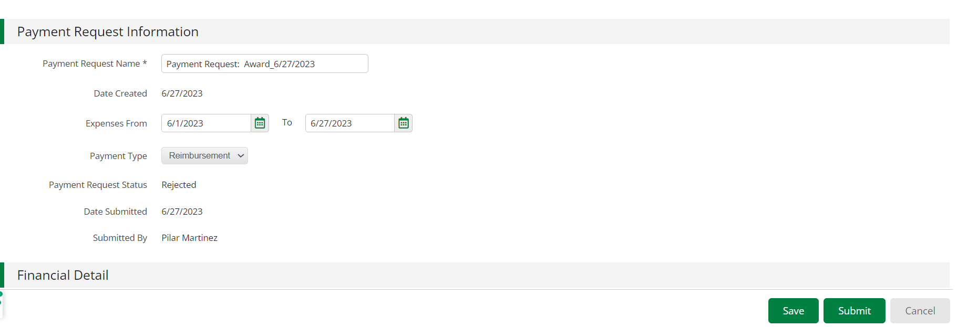
Resubmit a Rejected Payment Request
Fix errors identified by Funder in the payment request comment section.
From the Grant click on Post Award > Management > Payment Requests, identify rejected Payment Request and click on pencil
Fix any errors, and re-submit
Note: As of summer 2023, there’s no need to create a new Payment Request to fix a rejected Request.
1
3
2

Slide 29
Submitting an Amendment Request

Slide 30
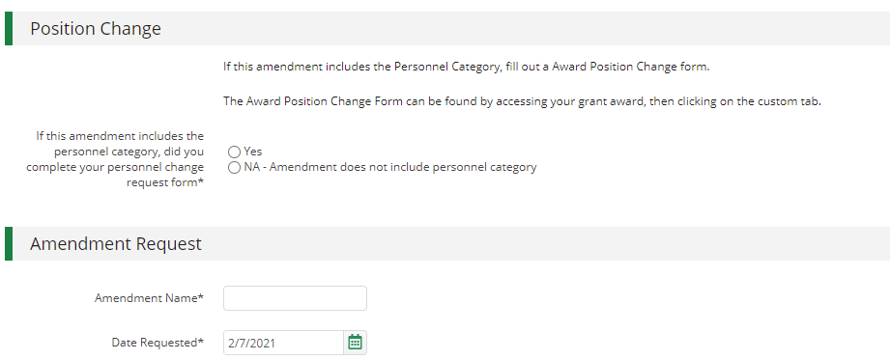
Generating an Amendment
From the Grant click on Post Award > Management > Amendments
Click on the plus icon in the upper right-hand corner
Click on (i)circle then (ii) text of amendment type
Enter amendment Information
Click Submit to Submit request to JWB
1
2
3
ii
i
4
5

Slide 31
Award Position Change Form & Other Program Funding Form

Slide 32
Award Position Change Form & Other Program Funding Form
From the Grant click on Custom > Award Position Change form OR Other Program Funding Form
Click on the plus icon in the upper right-hand corner
After information is entered click Create (bottom right-hand corner)
1
2
3

Slide 33
Available Reporting

Slide 34
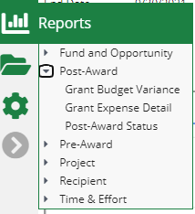
Available Reporting
Grant Dashboard
Other Reports

